Slide 1
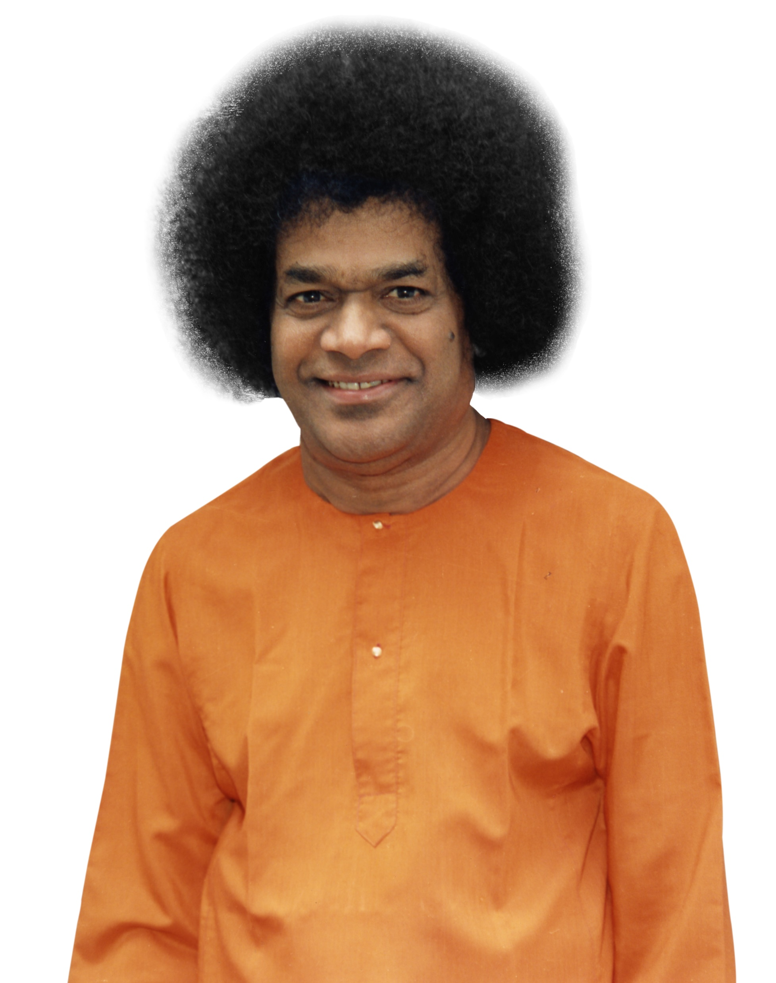
I offer my humble pranams at Bhagawan’s Lotus Feet

Slide 2

A Framework for Building Knowledge Graph from Unstructured Data: Pradhan Mantri Jan Arogya Yojana (PMJAY)
Master of Technology
(Computer Science)
Suvam Gurung
(Regd.No.: 20559)
SRI SATHYA SAI INSTITUTE OF HIGHER LEARNING
(Deemed to be University)
Department of Mathematics and Computer Science
Prasanthi Nilayam Campus
May, 2023

Slide 3
Contents
Introduction
Objective & Key Contributions
Literature Review
Knowledge Graph
Ayushman Bharat – PMJAY
Overall Process Flow of PMJAY
Methodology
Framework
Results
Conclusion and Future Scope
Bibliography

Slide 4
Introduction
Objective & Key Contributions

Slide 5
Objective & Key Contributions
Objective
Create a Framework to Build Knowledge Graph from Unstructured Data, primarily focusing on PMJAY’s overall process flow for a patient which are documented as PDFs.
Key Contributions
Framework that creates Graph Database from Unstructured Data
Training Corpus for Domain-Specific NLP Model for Entity-Recognition in PMJAY documents.
Domain-specific NER Model itself.

Slide 6
Literature Review
Knowledge Graph
Ayushman Bharat – PMJAY
Overall Process Flow of PMJAY

Slide 7
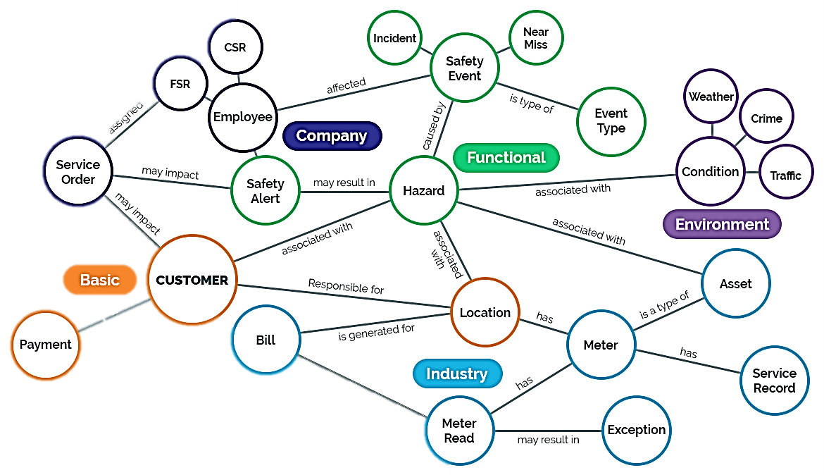
Knowledge Graph
Graph Database
Entities -> Nodes
Relationships -> Edges
Stores Semantic Information
Applications:
Search engines
Recommendation systems
Natural Language Processing
Social networks

Slide 8


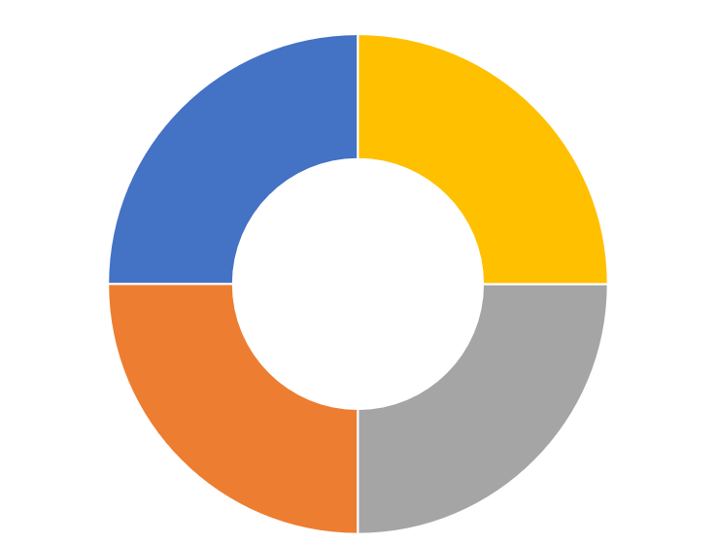
Ayushman Bharat: Pradhan Mantri Jan Arogya Yojana (AB-PMJAY)
Healthcare Scheme
1500 Medical Procedures
Pre- & Post Hospitalization Expenses
50 Crore Individuals
Notes:
A flagship healthcare program launched by the Government of India in September 2018
Aims to provide health coverage to vulnerable and economically disadvantaged families in India, including rural households and urban poor.
Covers more than 10.74 crore poor and vulnerable families, or approximately 50 crore individuals in India
Provides coverage for more than 1,500 medical procedures, including heart surgeries, knee replacements, and cancer treatments.
Covers pre- and post-hospitalization expenses, as well as transportation costs for patients who need to travel to the hospital.

Slide 9
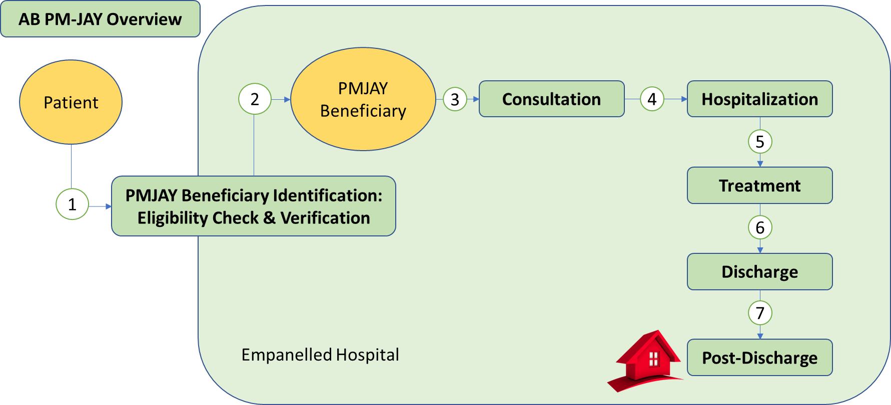
Overall Process Flow for a Patient
Notes:
A flagship healthcare program launched by the Government of India in September 2018
Aims to provide health coverage to vulnerable and economically disadvantaged families in India, including rural households and urban poor.
Covers more than 10.74 crore poor and vulnerable families, or approximately 50 crore individuals in India
Provides coverage for more than 1,500 medical procedures, including heart surgeries, knee replacements, and cancer treatments.
Covers pre- and post-hospitalization expenses, as well as transportation costs for patients who need to travel to the hospital.

Slide 10
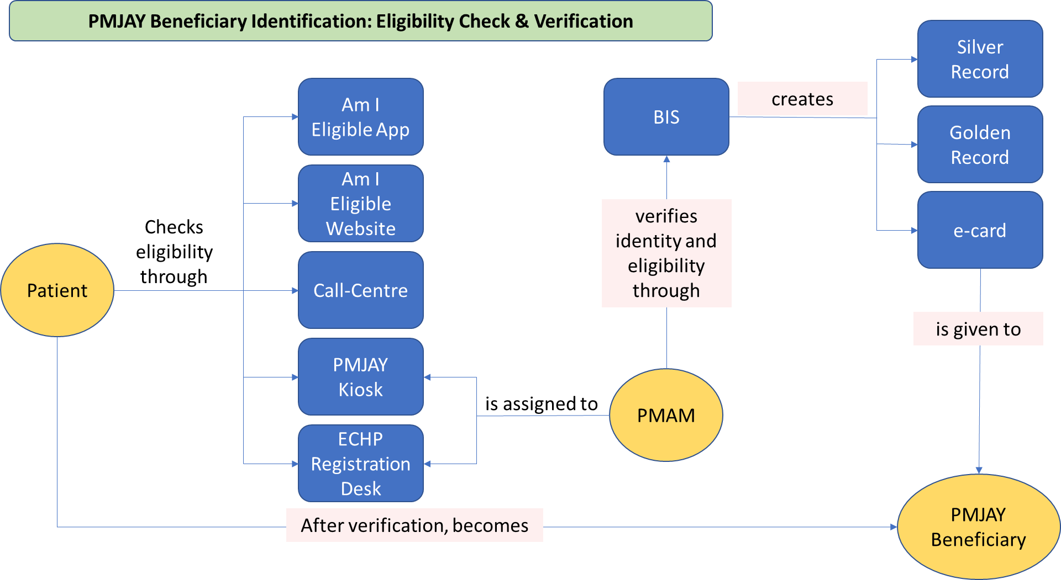
Beneficiary Identification
Overall Process Flow for a Patient

Slide 11
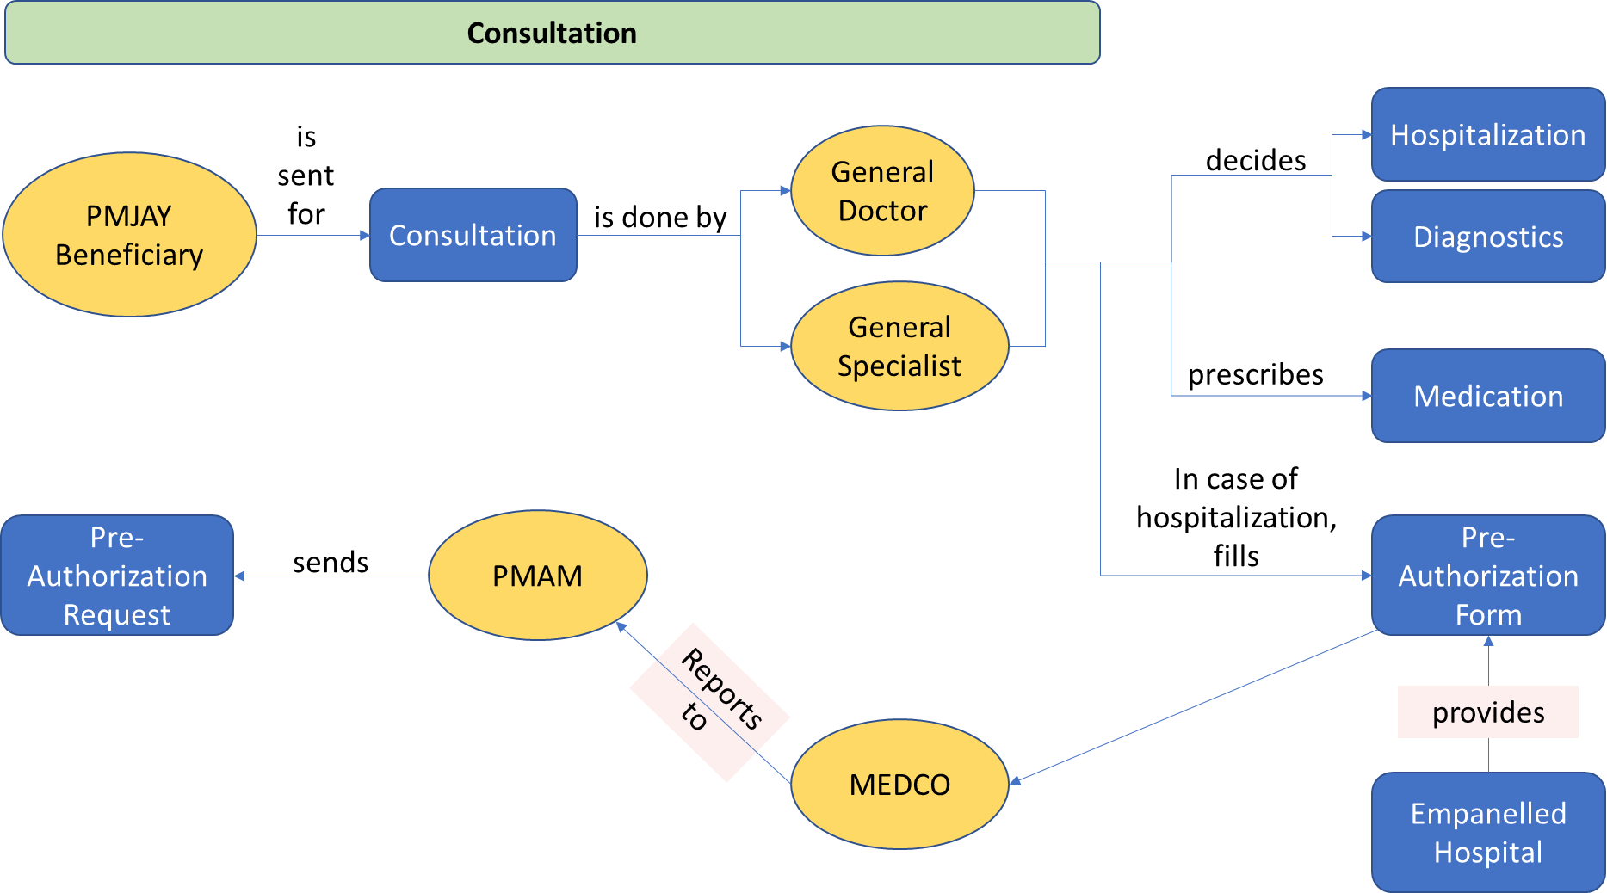
Consultation
Overall Process Flow for a Patient

Slide 12
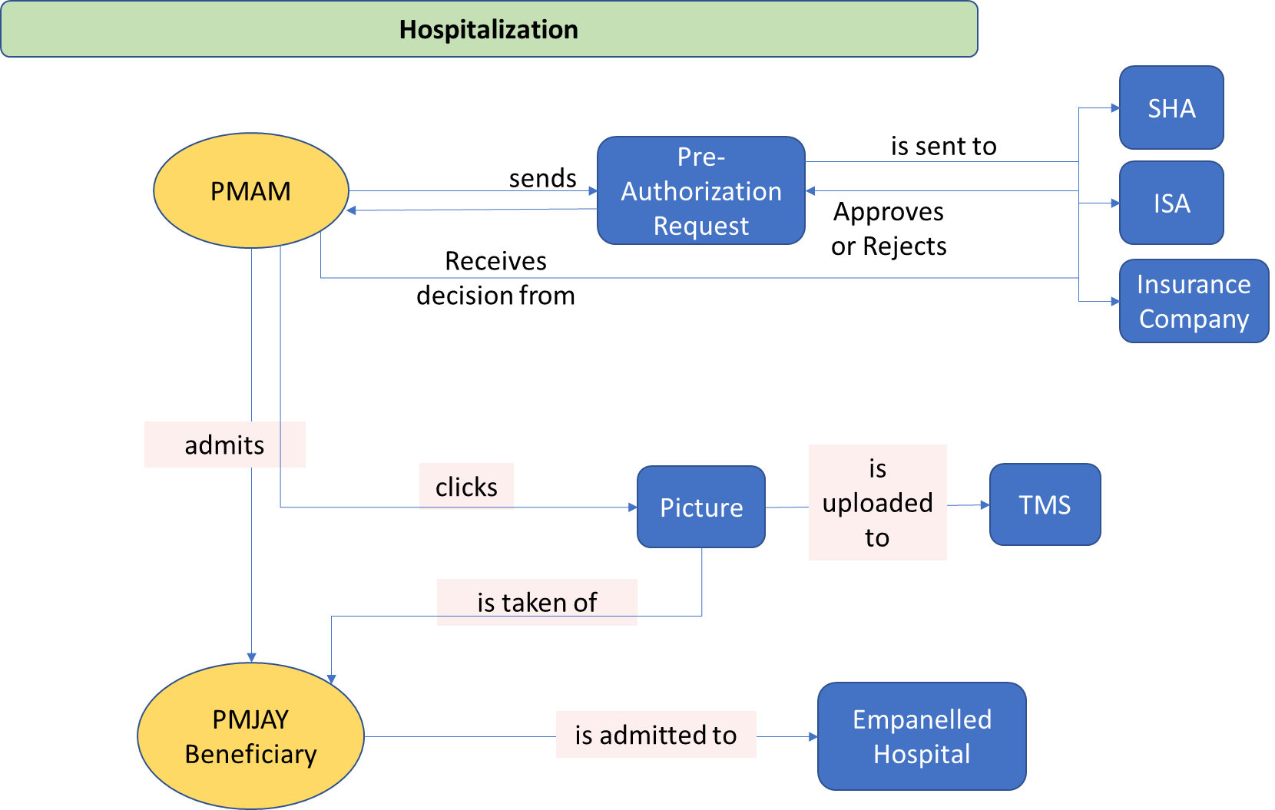
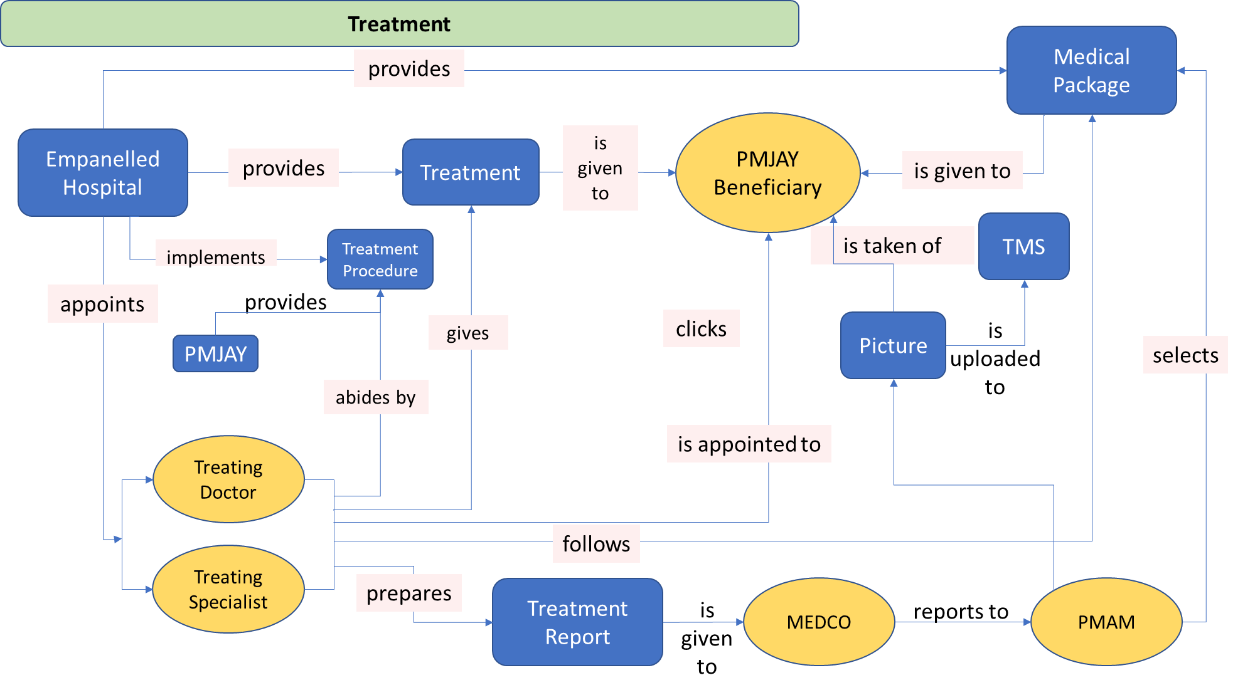
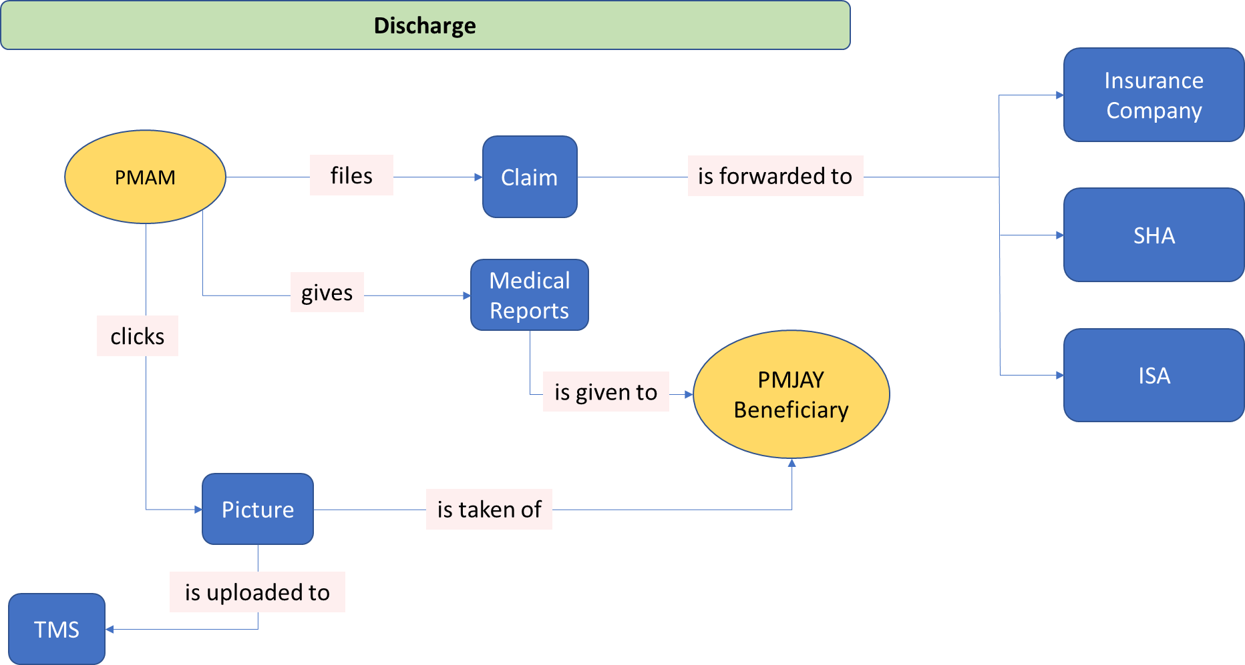
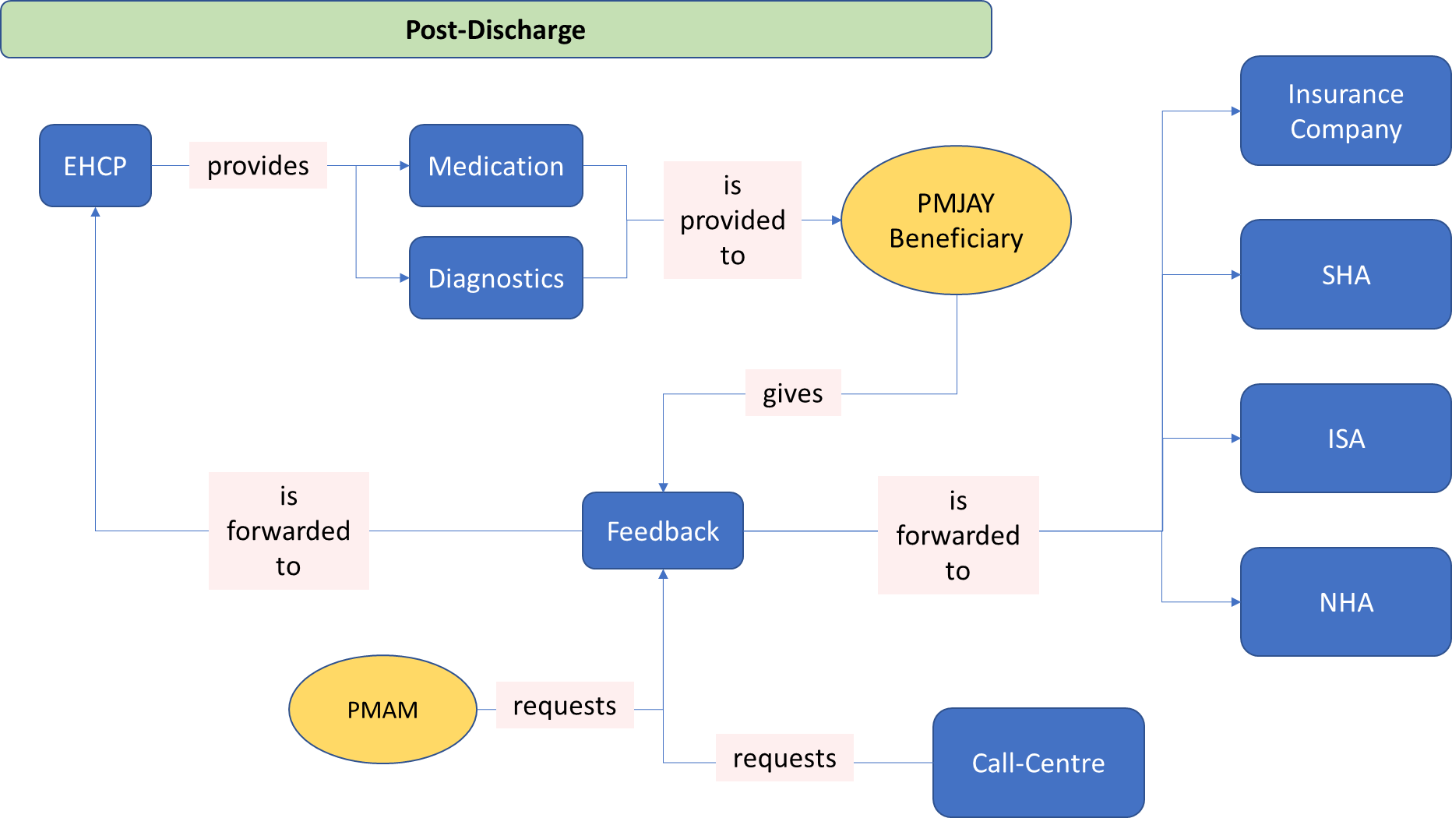
Overall Process Flow for a Patient

Slide 13
Objective & Key Contributions
Objective
Create a Framework to Build Knowledge Graph from Unstructured Data, primarily focusing on PMJAY’s overall process flow for a patient which are documented as PDFs.
Key Contributions
Framework that creates Graph Database from Unstructured Data
Training Corpus for Domain-Specific NLP Model for Named Entity Recognition in PMJAY documents.
Domain-specific NER Model

Slide 14
Behind the Scene
Overall Process Flow for a Patient

Slide 15
Overall Process Flow for a Patient
Organizations
ISA
SHA
NHA
Insurance Companies
Management Portals
BIS
TMS
Patient In
CSC
Hospital Processes
Patient Out
App/Website
EHCP Registration Desk
Consultation
Diagnosis
Hospitalization
PMJAY Kiosk
Call-Centre
Treatment
Discharge
Post Discharge
Notes:
A flagship healthcare program launched by the Government of India in September 2018
Aims to provide health coverage to vulnerable and economically disadvantaged families in India, including rural households and urban poor.
Covers more than 10.74 crore poor and vulnerable families, or approximately 50 crore individuals in India
Provides coverage for more than 1,500 medical procedures, including heart surgeries, knee replacements, and cancer treatments.
Covers pre- and post-hospitalization expenses, as well as transportation costs for patients who need to travel to the hospital.

Slide 16
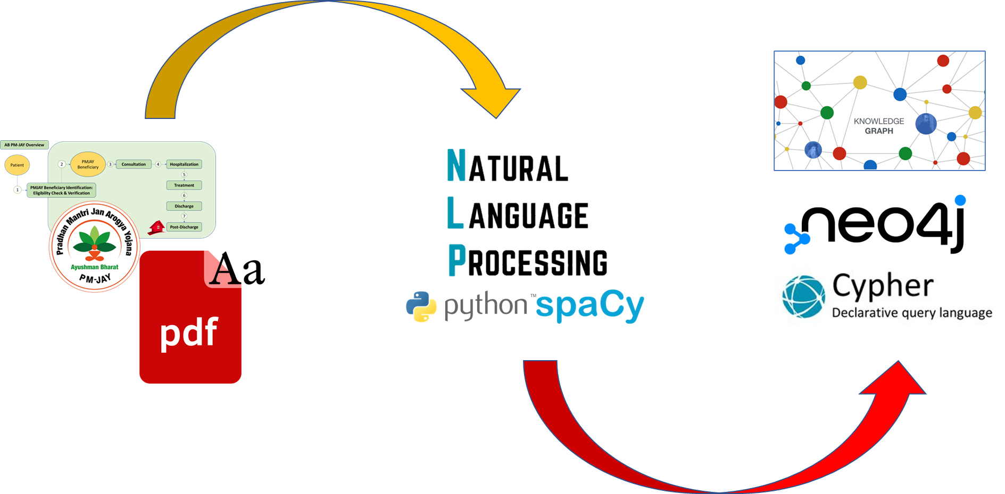
Methodology
https://pmjay.gov.in/resources/documents

Slide 17
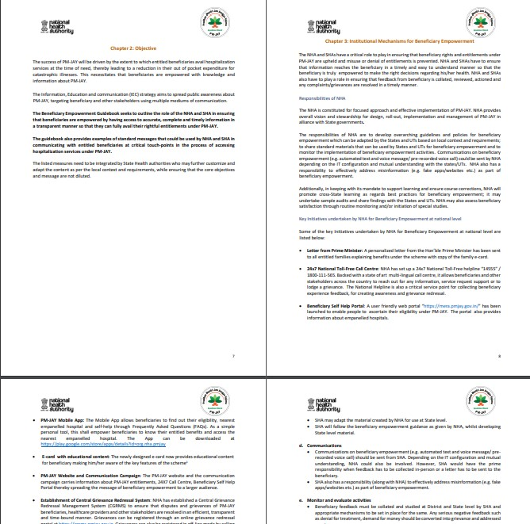
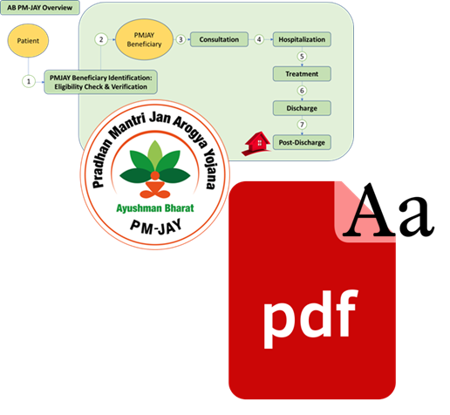




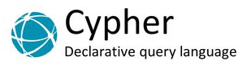
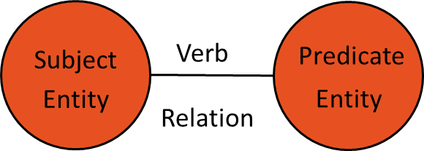

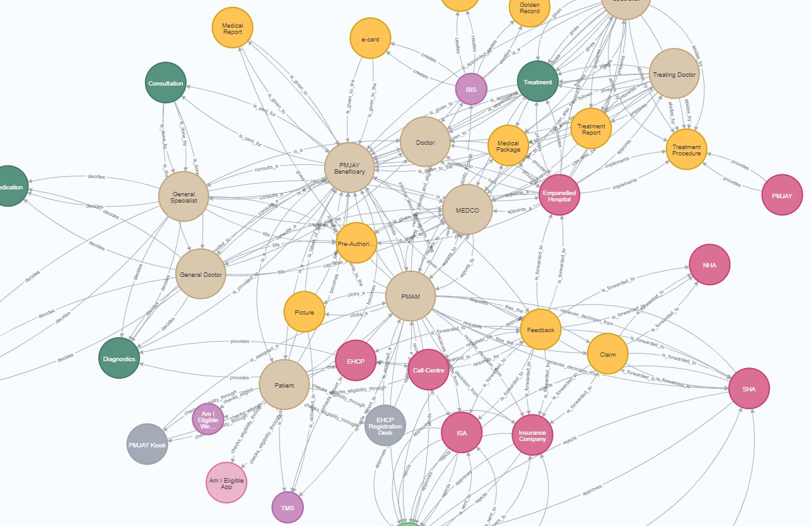

Framework
SpaCy NER
Annotation Tool
Training Corpus for Domain-Specific NLP for NER
PMJAY Admission Process Flow PDFs
Extract text from PDF
Data Cleaning
Input
1
2
3
4
8
7
6
5
NLP Model Training
Output
Formation of Triads for Knowledge Graph
Entity and Relations Extraction
Knowledge Graph

Slide 18
Framework
SpaCy NER
Annotation Tool
Training Corpus for Domain-Specific NLP for NER
PMJAY Admission Process Flow PDFs
Extract text from PDF
Data Cleaning
Input
1
2
3
4
8
7
6
5
NLP Model Training
Output
Formation of Triads for Knowledge Graph
Entity and Relations Extraction
Knowledge Graph
8/13

Slide 19
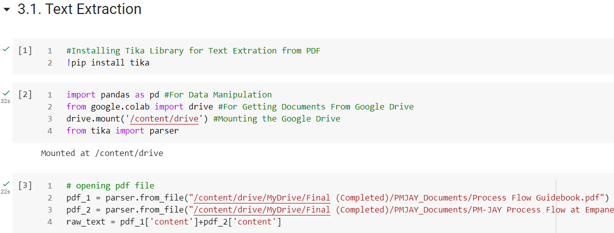
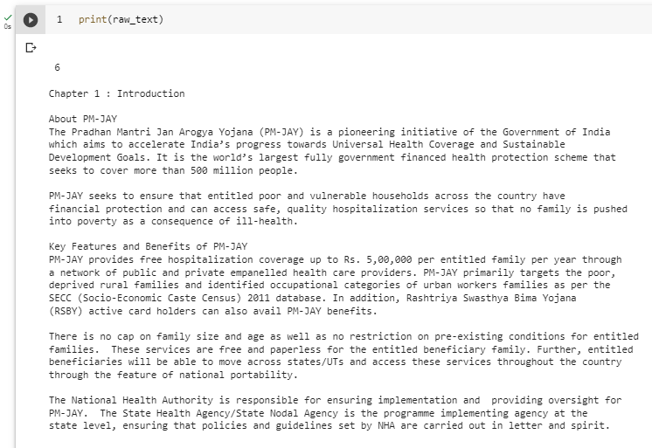
Framework: Text Extraction
2
Text Extraction
3
Extract text from PDF
Raw Text
1
PMJAY PDF Documents

Slide 20
Framework
SpaCy NER
Annotation Tool
Training Corpus for Domain-Specific NLP for NER
PMJAY Admission Process Flow PDFs
Extract text from PDF
Data Cleaning
Input
1
2
3
4
8
7
6
5
NLP Model Training
Output
Formation of Triads for Knowledge Graph
Entity and Relations Extraction
Knowledge Graph
8/13

Slide 21

Framework: Data Cleaning
Level 1 Refinement
Trailing Spaces
Level 2 Refinement
Ambiguity due to abbreviations and variations of words
Level 3 Refinement
Duplicate words
New Lines
Characters
Numberings

Slide 22
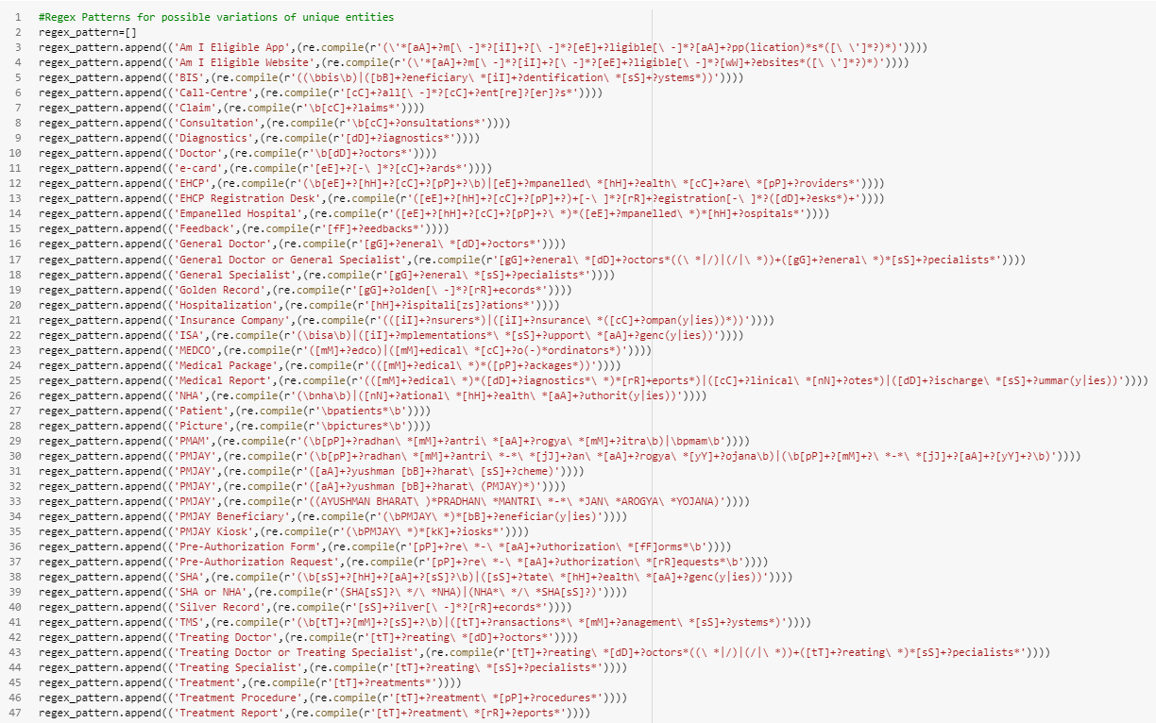
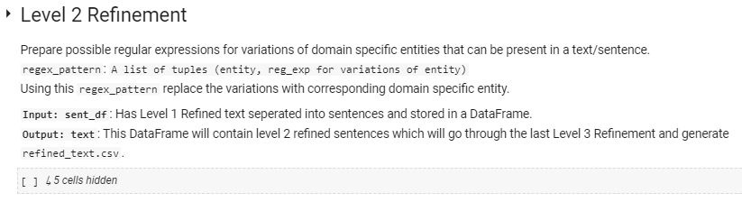
Framework: Data Cleaning - Level 2 Refinement
Data Cleaning

Slide 23
Framework
SpaCy NER
Annotation Tool
Training Corpus for Domain-Specific NLP for NER
PMJAY Admission Process Flow PDFs
Extract text from PDF
Data Cleaning
Input
1
2
3
4
8
7
6
5
NLP Model Training
Output
Formation of Triads for Knowledge Graph
Entity and Relations Extraction
Knowledge Graph
8/13

Slide 24
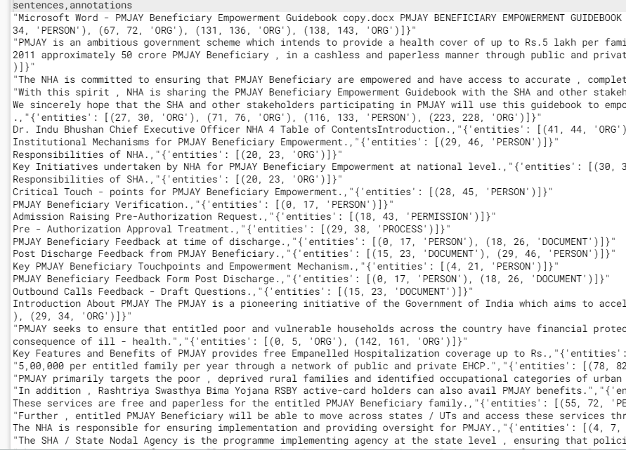
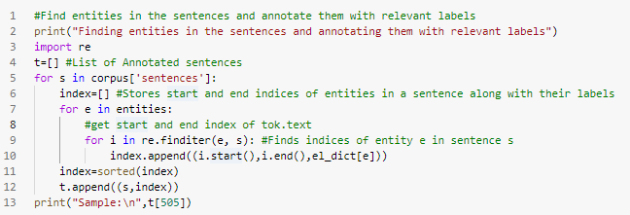
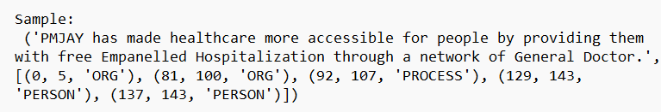
Framework: Training Corpus for Domain-Specific NLP for NER
1
3
Raw Text
2
4

Slide 25
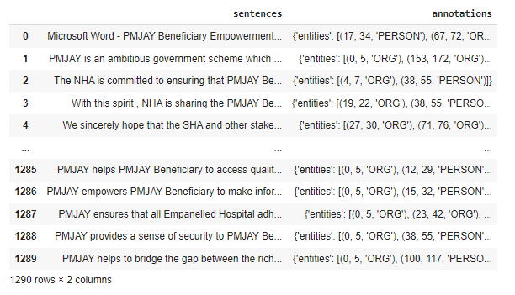
Framework: Training Corpus for Domain-Specific NLP for NER

Slide 26
Framework
SpaCy NER
Annotation Tool
Training Corpus for Domain-Specific NLP for NER
PMJAY Admission Process Flow PDFs
Extract text from PDF
Data Cleaning
Input
1
2
3
4
8
7
6
5
NLP Model Training
Output
Formation of Triads for Knowledge Graph
Entity and Relations Extraction
Knowledge Graph
8/13

Slide 27
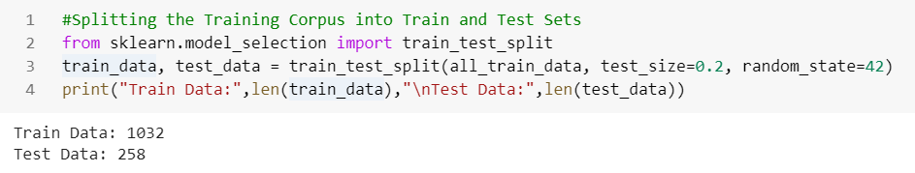
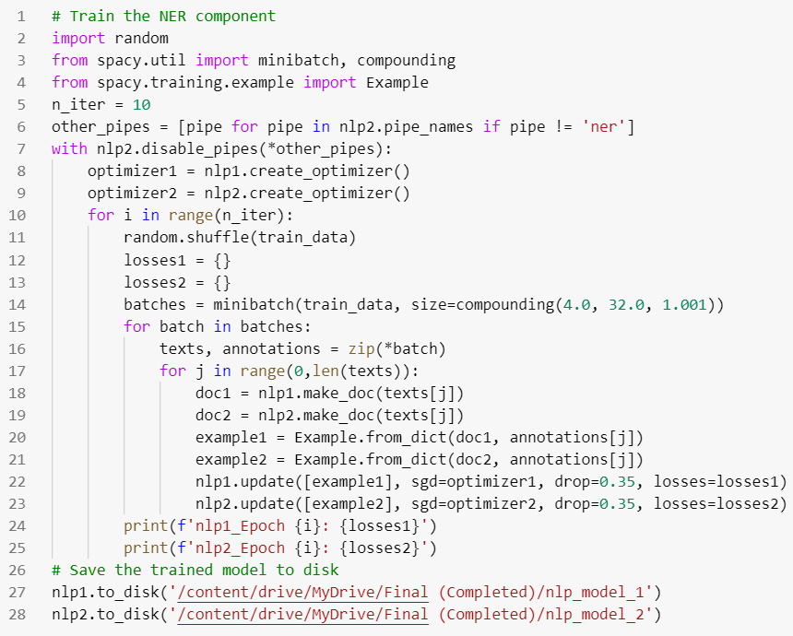
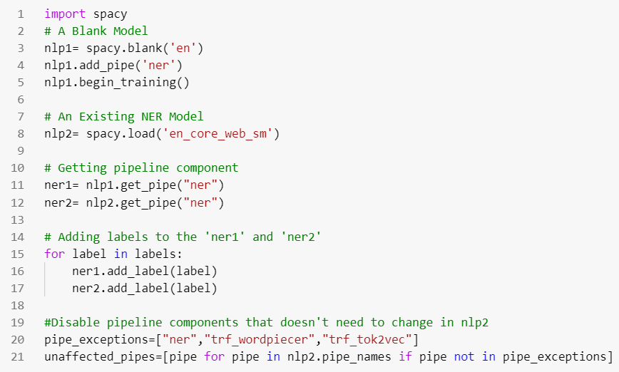
Framework: Training spaCy NER Model
NLP Model Training
Train - Test Split
3
NER Training
1
2
Getting Base Models

Slide 28
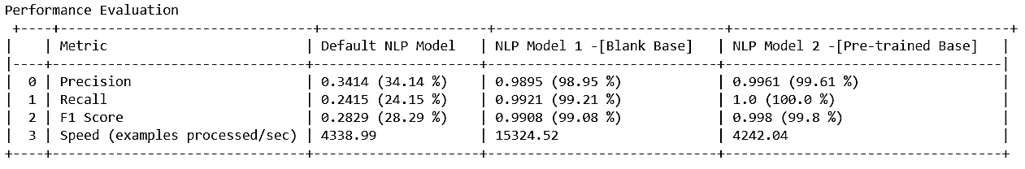
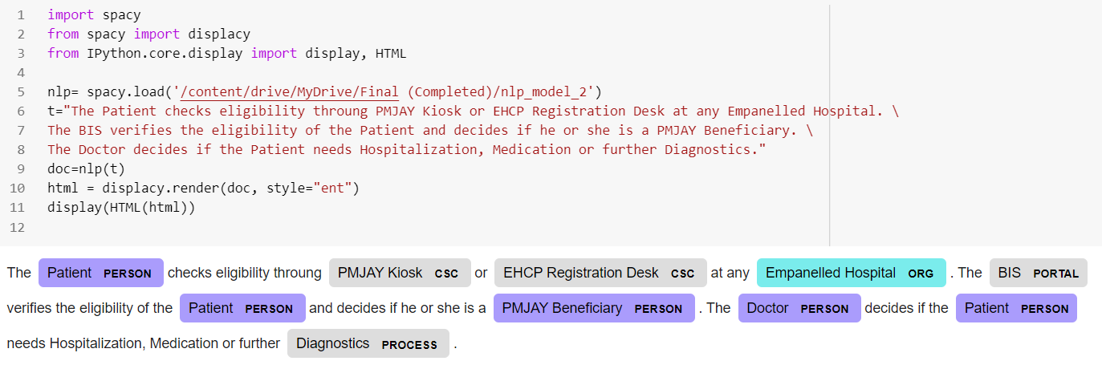
Framework: Model Performance
F1 Score = 2 * (precision * recall) / (precision + recall)
NLP Model 2 – [Pre-trained Base]

Slide 29
Framework
SpaCy NER
Annotation Tool
Training Corpus for Domain-Specific NLP for NER
PMJAY Admission Process Flow PDFs
Extract text from PDF
Data Cleaning
Input
1
2
3
4
8
7
6
5
NLP Model Training
Output
Formation of Triads for Knowledge Graph
Entity and Relations Extraction
Knowledge Graph
8/13

Slide 30
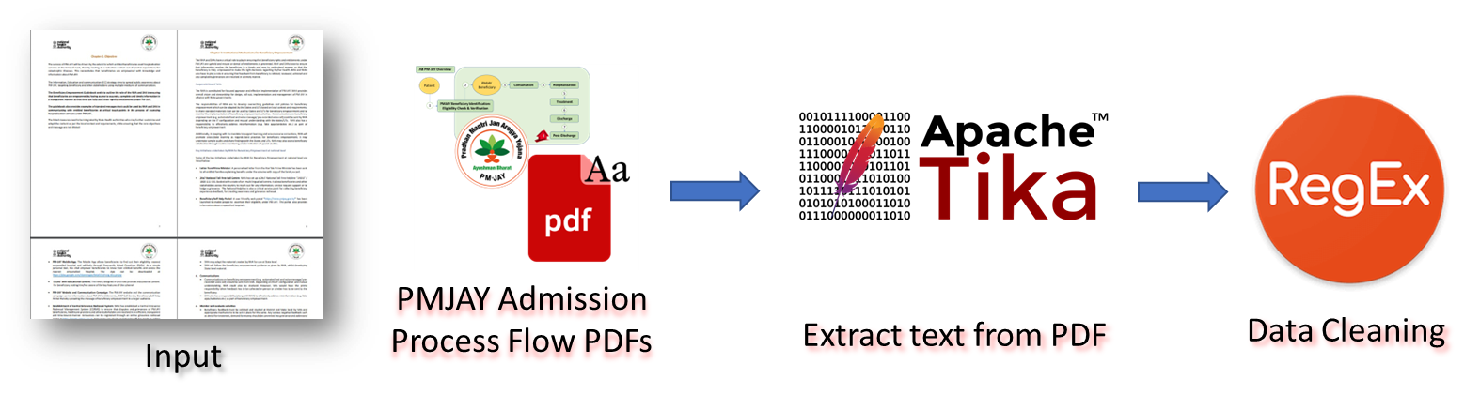
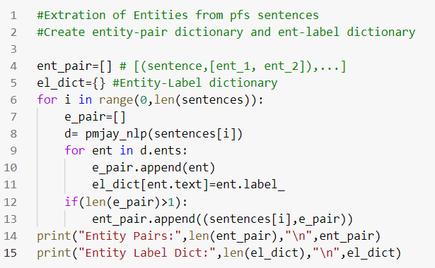
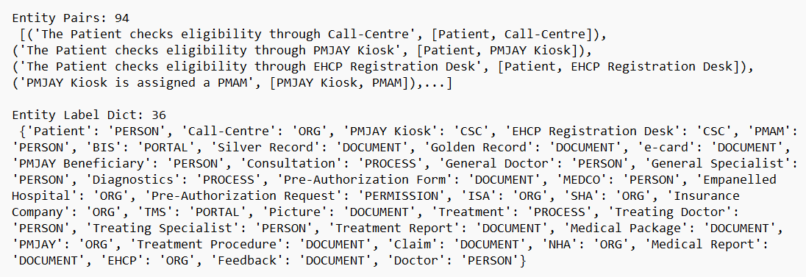
Framework: Entity Extraction
Data Pre-Processing
3
1
Entity Extraction
2
Domain Specific NER Model
4
Extracted Entities

Slide 31
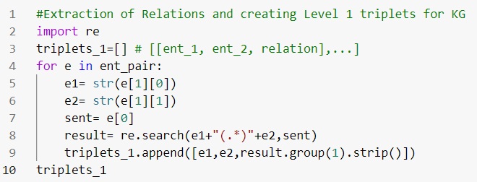
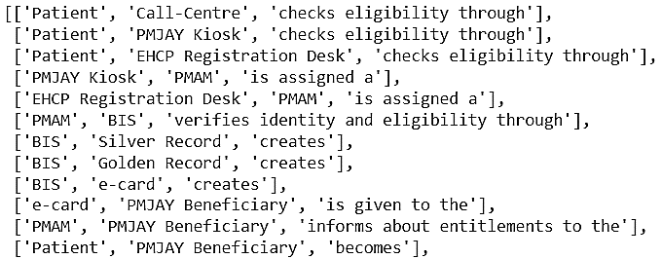
Framework: Relation Extraction
1
Extracted Entities
Relation Extraction
2
3
Entities with Relations

Slide 32
Framework
SpaCy NER
Annotation Tool
Training Corpus for Domain-Specific NLP for NER
PMJAY Admission Process Flow PDFs
Extract text from PDF
Data Cleaning
Input
1
2
3
4
8
7
6
5
NLP Model Training
Output
Formation of Triads for Knowledge Graph
Entity and Relations Extraction
Knowledge Graph
8/13

Slide 33
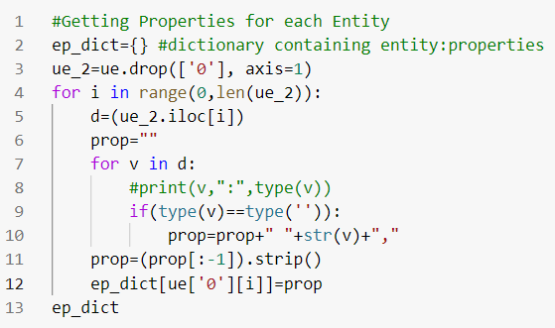
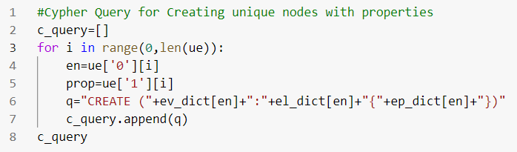
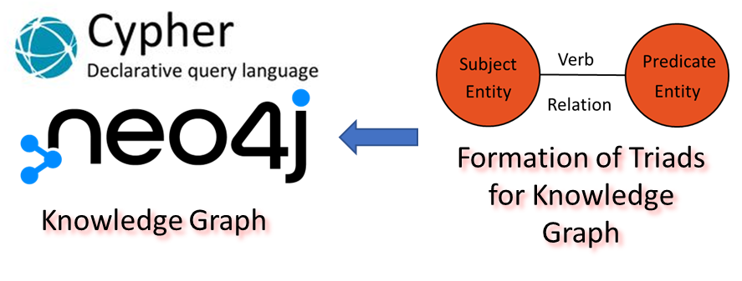
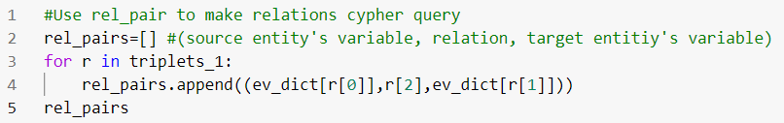
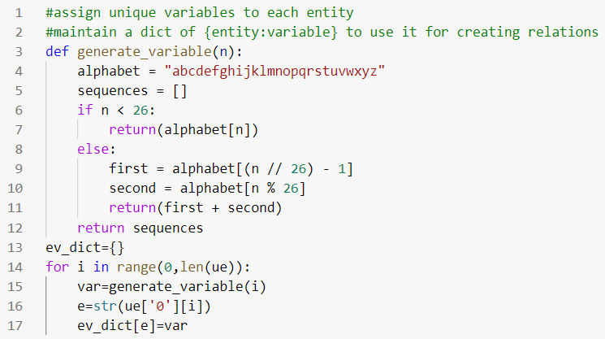
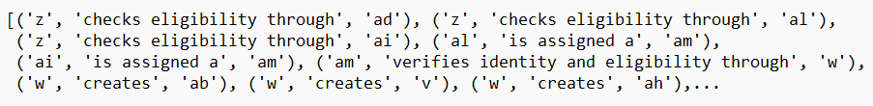
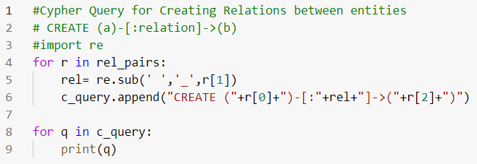
Framework: Creation of Triads and Cypher Script
3
1
4
2
5

Slide 34
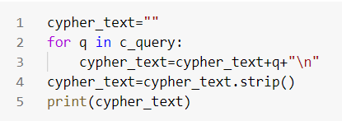
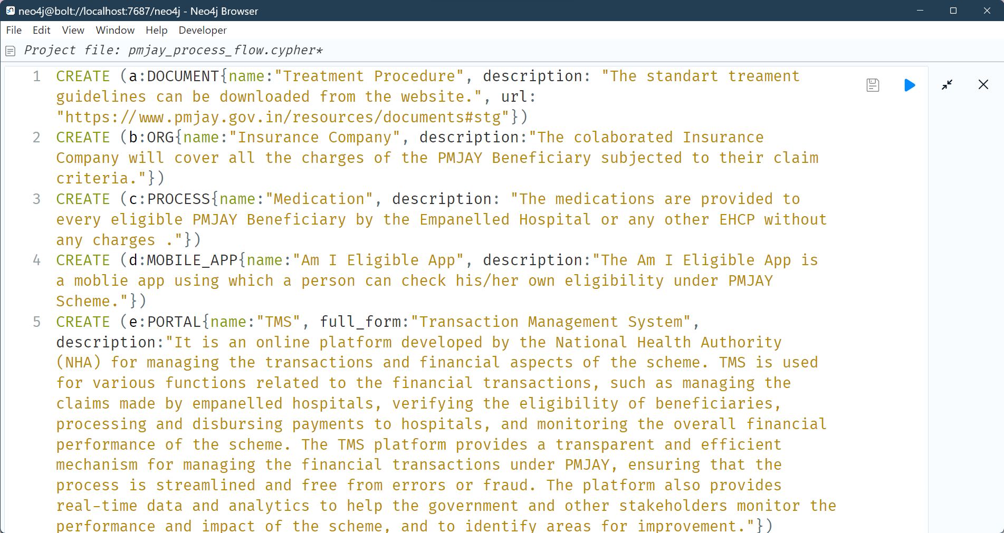
Framework: Creation of Triads and Cypher Script
1
Creating Cypher Queries
2
List to String
4
3
Creating a Cypher Script

Slide 35
Framework
SpaCy NER
Annotation Tool
Training Corpus for Domain-Specific NLP for NER
PMJAY Admission Process Flow PDFs
Extract text from PDF
Data Cleaning
Input
1
2
3
4
8
7
6
5
NLP Model Training
Output
Formation of Triads for Knowledge Graph
Entity and Relations Extraction
Knowledge Graph

Slide 36
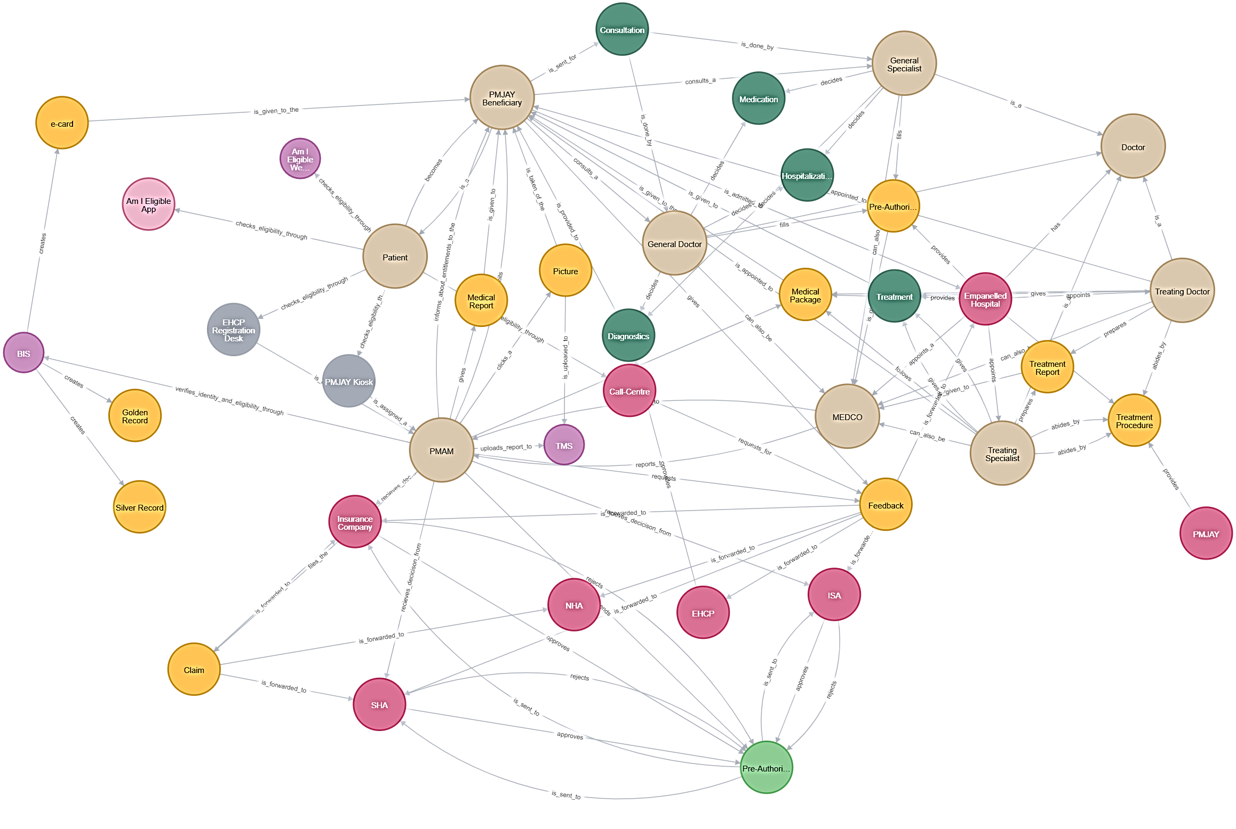

Results : PMJAY Overall Process Flow

Slide 37
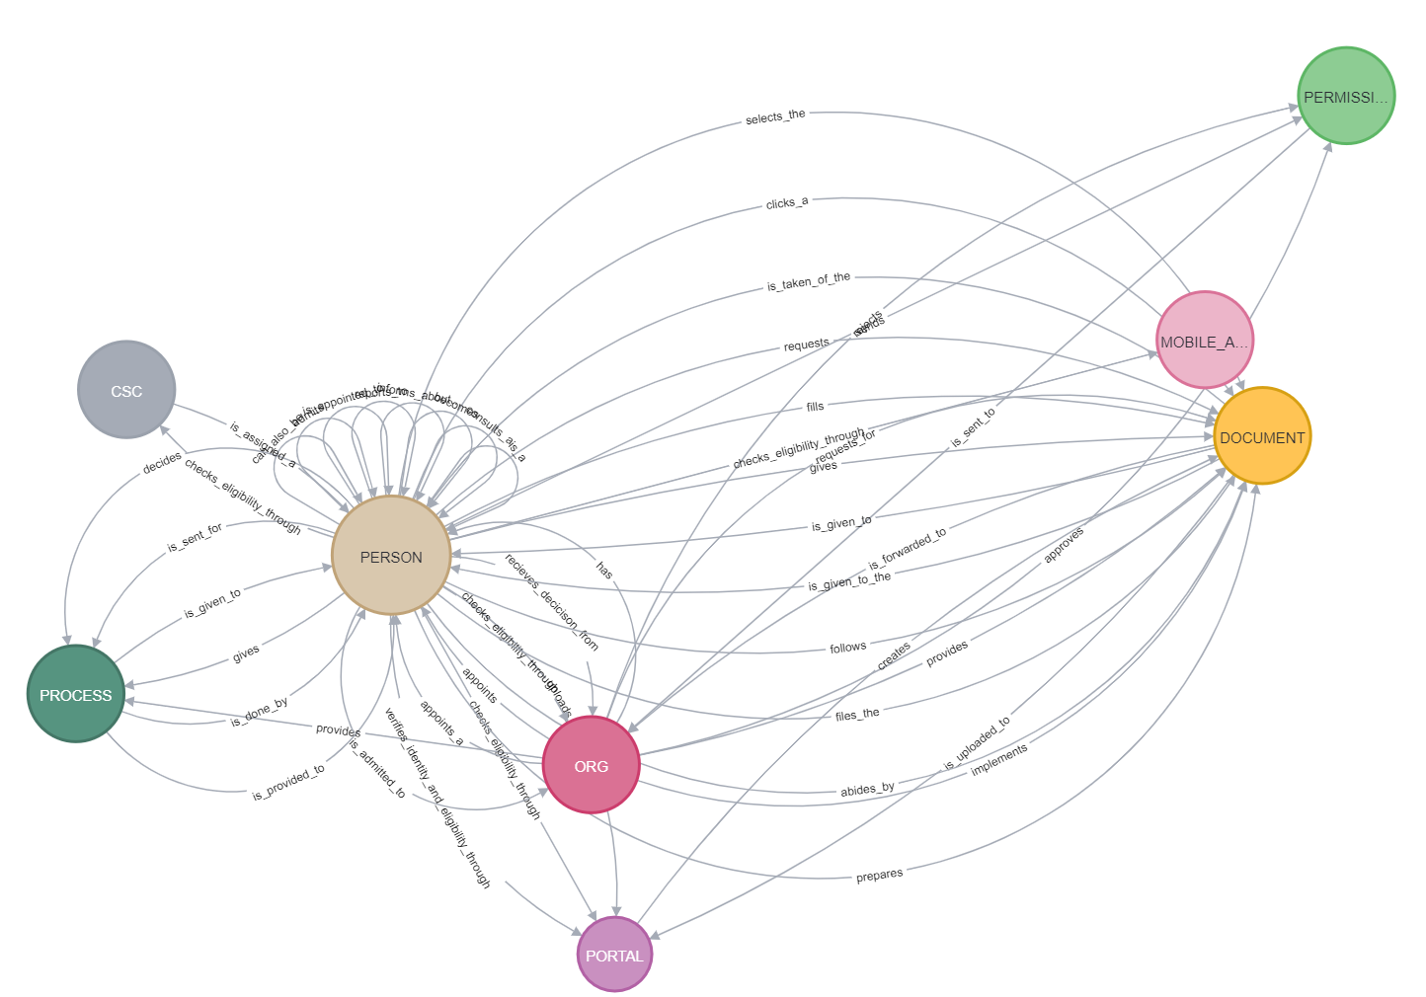
Results

Slide 38
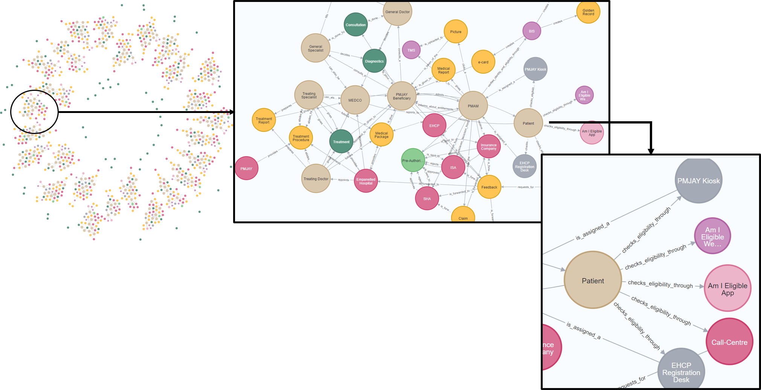
Results : PMJAY Admission Process Flow Knowledge Graph for Dummy Records

Slide 39
Conclusion
We have built a framework using which one can build a Knowledge Graph from unstructured data.
We have built a Named Entity Recognition Model for PMJAY, which could be used by for:
Information Extraction from their vast repository of unstructured data.
Building ChatBots for their website
Document Classification
To substantiate the NER model, we also have the training corpus and the framework to train the model.
Regular expressions for data cleaning of PMJAY documents.

Slide 40
Future Scope
Future Scope
We can use web scraper to collect more data on the domain.
Relation Extraction can be improved with word-dependency analysis so its extraction can handle complex sentences too.
Use of other NLP tools like huggingface’s bio-bert model can improve the NER model.
Entity Resolution can be done on the built Knowledge Graph.
Graph ML Models can be applied on Knowledge Graphs.
Interpretability of ML Models could be analysed.

Slide 41
Future Scope
Bibliography
[1] Accern. Named entity recognizition (ner) uses for unstructured text. https://accern.com/blog/extracting-information-from-unstructured-text/
[2] Bharat, A. Ayushman bharat - pradhan mantri jan arogya yojana (pm-jay), national health authority, government of india. https://pmjay.gov.in/about/pmjay
[3] Bharat, A. Ayushman bharat: An overview. national health authority, government of india. https://nha.gov.in/PM-JAY
[4] Bonatti, P. A., Decker, S., Polleres, A., and Presutti, V. Knowledge graphs: New directions for knowledge representation on the semantic web (dagstuhlseminar 18371). In Dagstuhl reports (2019), vol. 8, Schloss Dagstuhl-Leibniz-Zentrum fuer Informatik.
[5] Medium. Comparison of python nlp libraries. https://medium.com/activewizards-machine-learning-company/comparison-of-top-6-python-nlp-libraries-c4ce160237eb

Slide 42
Future Scope
Bibliography
[6] Neo4j. Neo4j desktop. https://neo4j.com/
[7] NTU. Regular expressions. https://www3.ntu.edu.sg/home/ehchua/programming/howto/Regexe.html
[8] OpenAI. Openai. https://platform.openai.com/docs/quickstart
[9] Vidya, A. Building knowledge graph. https://www.analyticsvidhya.com/blog/2019/10/how-to-build-knowledge-graph-text-using-spacy/
[10] SpaCy. Natural language processing using spacy. https://spacy.io/
[11] SpaCy. Spacy api. https://spacy.io/api
[12] SpaCy. Spacy nlp model performance evaluation. https://spacy.io/api/scorer
Neo4j tutorial. https://www.tutorialspoint.com/neo4j/index.htm

Slide 43
A Framework for Building Knowledge Graph from Unstructured Data: Ayushman Bharat – Pradhan Mantri Jan Arogya Yojana
Master of Technology
(Computer Science)
Suvam Gurung
(Regd.No.:20559)
SRI SATHYA SAI INSTITUTE OF HIGHER LEARNING
(Deemed to be University)
Department of Mathematics and Computer Science
Prasanthi Nilayam Campus
May, 2023

